Slide 1
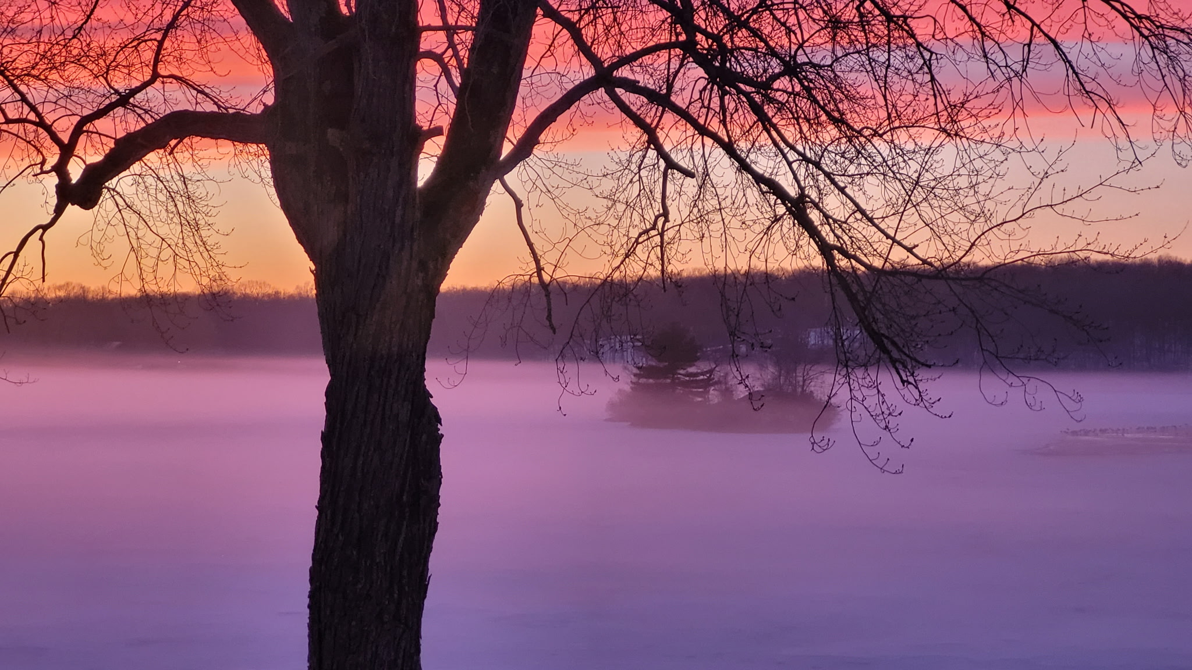
Amston Lake District
Annual Meeting
May 30, 2026

Slide 2
Agenda
Call to Order
Roll Call of Officers and Directors
Introduction of Board of Directors
Acknowledgements
Approve May 31, 2025 Meeting Minutes
Review of Lake Operations and Committees
Election of ALD Board of Directors and Board Officers
Tax Collector and Treasurer’s Reports
Consider and Act Upon the Proposed Budget for FY 2026-2027
Consider and Act Upon Special Project-Dock Expansion
Establish Date for the 2027 District Annual Meeting
Adjournment

Slide 3
2025 – 26 Board of Directors
Brandon Pelegano, President
Karen Patterson, Vice President
Liz Bowen, Clerk
Jim Caines, Treasurer
Jeff Arpin, Director
Jeff Greenfield, Director
Teri Nixon, Director
Cathie Rockoff, Director
Karen Rustico, Director

Slide 4
Approval of May 31, 2025 Annual Meeting Minutes
Motion/Second to approve the minutes
Any discussion?
All in favor?

Slide 5
Review Lake Operations
Continued hybrid monthly board meeting format
Newsletter is available
Continued distribution of welcome packages to
new residents
Continued the pre-filled online registration form for beach, parking, and boat passes for those registered
the year prior
6th year of resident Beach Pass Checkers

Slide 6
Lebanon Roads Committee
Members: Brandon Pelegano (chair), Jim Caines,
Jodie Stubbings, Mary Withey
Maintain 16 private roads in Lebanon
Plowed 9 storms and sanded 31 times
First Year of maintenance contract for pothole repair – SUCCESSFUL
  Contractor responsible for the following:
    Reviews road status after storms and quickly makes repairs
    Fixes all potholes, removes downed trees
    Cleans out waterways on roadside, catch basins
    Spreads and crowns as much process as the District can afford
Notes:
10 loads of process spread

Slide 7
Lake Health Committee
Members: Jeff Arpin (Chair), Murray Cruickshank, Kathy Feldman, Duncan Keith, Ari Novis, Les Parlin, and Jean Waleszczyk
Activities
  Limnologist, town, DEEP, CAES, CFL, and treatment specialist interface
  Beach water (weekly), stormwater (heavy rain) and deepwater (biweekly) sampling and data summary reporting
  Monitor catch basin debris and cleaning for sediment and erosion control
  Invasive plant management (permits, inspections, monitoring, coordination, education)
  District resident support (shoreline inspections, benthic barriers, cattail and algae management) and organized educational presentations by GZA,
  CAES to District
  Lake Health web page updates with reports, analysis, lake nutrient data, educational material, all past limnology, bathymetry and aquatic plant
  survey reports
  Attended educational seminars with DEEP, CAES and CFL to gain more knowledge and presented general lake health at other lake communities and CFL events

Slide 8
What Can You Do To Help?
Test your lawn before any treatment and do not fertilize if the soil tests fine for your uses; leave lawn clippings, use compost, and pick up pet droppings
Remember fertilizer that makes your lawn grow makes the plants in the lake grow
If using a contractor to fertilize your lawn, read the MSDS sheet and look for any impacts on fish, waterfowl, and water quality
We strongly recommend not using a lawn treatment service; heavy rains may push chemicals straight into the lake immediately following treatment

Slide 9
What Can You Do To Help?
All homeowners are lakefront property; our stormwater system collects all watershed water and sends it straight to the lake
Connecticut law forbids the use of phosphorus on established lawns; UCONN notes – phosphorus is the number one cause of declining water quality in fresh water lakes and ponds in Connecticut
PLEASE visit the ALHC web page for information and educational resources; contact the ALHC with any questions
Look for invasive plants - especially Eurasian watermilfoil and hydrilla; report to a board member or ALHC
PLEASE make sure your watercraft is spotless (inside and out) if it has been in another body of water

Slide 10
PROTECT OUR LAKE
PLEASE DO NOT ALLOW LAWN PESTICIDES, HERBICIDES, OR PHOSPHORUS TO ENTER DISTRICT WATERS OR PROPERTY

Slide 11
Beaches and ROWs Committee
Members: Teri Nixon (Co-Chair) and Karen Patterson (Co-Chair)
Committee Volunteers: Linda Farina, Kathy Feldman,
Jan Garrett, Karen Hinch, Marge Nichols, Cherie Shaft,
Lisa Salerno, John Slauenwhite, Jodi Stubbings, and Mary Withey
A special thank you to our Master Gardener, Sherri Martin
Coordinated fall and spring cleanup of beaches and
ROWs, including leaf and branch removal and cleaning of
memorial benches
Maintained landscaping on beaches and ROWs, including trimming of bushes and planting lake-friendly vegetation approved by our Master Gardener
Repairs and maintenance - boat rack repairs, scheduled raking of both beaches throughout the summer
Maintenance of plunge pools as needed
Survey of Elsmere ROW completed

Slide 12
Dams Committee
Members: Karen Patterson (Chair), Jeff Arpin, Donna Ciarfella, Jim Deslisle, Julia Giuliano, Jeff Greenfield, Brandon Pelegano
Activities:
  Committee formed in November 2025
  November 8, 2025: Reviewed the Emergency Action Plan (EAP) for the dam, discussed dam failure simulation with the Hebron Director of Emergency Management and the dam’s engineer
  Updated, enhanced, and filed the EAP and with the CT Dept of Energy and Environmental Protection (DEEP) as required
  Partnered with Hebron Emergency Management to schedule local Community Emergency Response Team (CERT) training
  Obtained quotes from several engineering firms to inspect Main Dam (legally required every 5 years); will get a second opinion on Duck Pond Dam; will coordinate dam inspections later in 2026
  Conduct monthly and quarterly inspections of Main Dam; recommend necessary repairs to BOD
  Communications to be shared with residents regarding potential flood zones, should the dam ever breach

Slide 13
Dock Committee
Members: Jim Caines (Chair), Brandon Pelegano,
JD Wilcox, Donna Ciarfella, Cathie Rockoff, Mary Withey
  Review current dock slip inventory versus interest
  Develop an expansion plan as determined appropriate including costs and installation timeframe
  Deliver recommendations to board for review
  If board approves recommendation, present to district for vote

Slide 14
Long-Term Financial Planning Committee
Members: Karen Patterson (Chair), Jim Caines, Jay Gallant, Julia Giuliano, Lisa Gonsor
Activities:
  Monitor long-term (more than one fiscal year) anticipated expenses for the District, to help smooth out tax impact of anticipated needs
  Make recommendations to the BOD regarding formation and funding of $$ to meet specific long-term financial needs, examples include:
    ALA Clubhouse Capital Improvements
    Dam Expenditures
    Dock Improvements
  Recommend to BOD investment options to maximize interest to the District, while minimizing financial risk

Slide 15
Lake Usage Committee
Members: Frank Hoisl (Chair), Todd Angelucci,
Duncan Keith, Barbara Lederer, Brandon Pelegano, Karen Rustico, Jean Waleszczyk
Focus areas impacting lake usage and enjoyment:
  Algae blooms
  Muck
  Weeds
Goals 2026
  Littoral zone survey of lake vegetation with use of underwater camera system
  Sediment phosphorous and depth evaluation

Slide 16

ALA Information – John Matra
Notes:
John Matra- president of Amston Lake Association

Slide 17


Slide 18
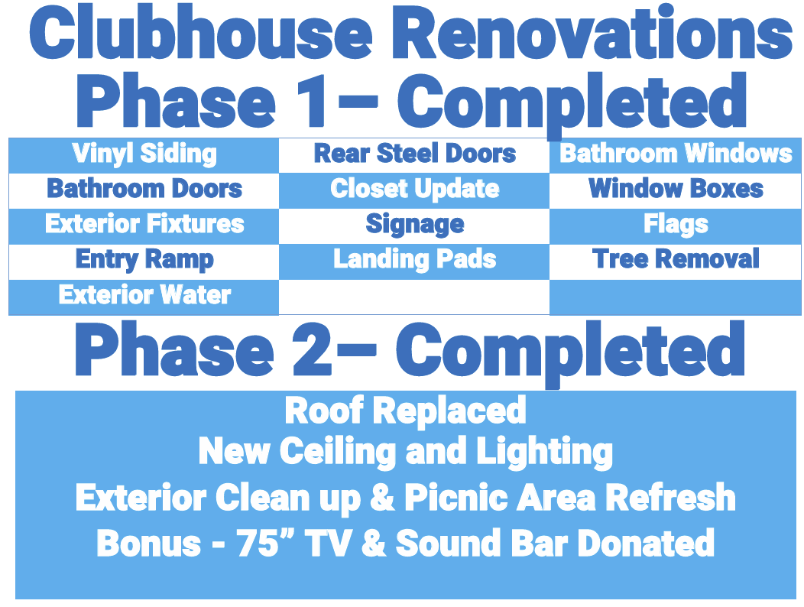

Slide 19


Slide 20
Volunteer Recognition
The Board would like to recognize all the volunteers who stepped up to lend a hand throughout the year
These donated hours helped greatly in reducing costs, saving time and building community spirit
The $$$ saved due to all of our wonderful volunteers is truly amazing and it is because of you that our district remains clean, safe and beautiful
If you have yet to volunteer…what are you waiting for???
Come out to help, meet your neighbors and…save tax dollars!

Slide 21
Remaining Beach and Boat Pass Distribution Dates
Saturday, June 13, 10 a.m. to noon
Sunday, June 28, 10 a.m. to noon
If you cannot make these last two dates, check the website for additional details
ALA Clubhouse
16 Wood Acres Road

Slide 22
Elections for 2026 - 2027
Board Members
  Liz Bowen*
  Karen Rustico*
  Teri Nixon
Officers
  President
  Vice President
  Treasurer
  Clerk
  *Planning to run again

Slide 23
Nominate Directors
Open positions: 3 in total
Three, 3-year terms:
  Open
  Open
  Open
Nominations
Vote

Slide 24
Elect Officers for 1-Year Term
President
  Nominees
  Time to Vote
Vice President
  Nominees
  Time to Vote
Treasurer
  Nominees
  Time to Vote
Clerk
  Nominees
  Time to Vote

Slide 25
Year to Date Financials
2027 Budget

Slide 26
Order of Presentation
Year-to-date results – April 30, 2026
  Tax Collections Report – Overall
  Year-to-date results by Fund
  Fund Balances
  Bank Balances
Budget History
FYE 6-30-2027 Proposed Spending Plan & Tax Request
  General Fund
    Incl Dam Inspection
  Roads Fund
  Special Project Dock Fund

Slide 27
YTD Tax Collections
AMSTON LAKE DISTRICT
TAX COLLECTIONS
FISCAL YEAR-TO-DATE - APRIL 30, 2026
2026 TAXES ($209,000 PLUS $40,000) $249,000
TOTAL CURRENT TAX COLLECTIONS - $231,322 (93.2%)
TOTAL BACK TAX COLLECTIONS - $1,015
TOTAL TAXES COLLECTED THIS FISCAL YEAR $232,337
INTEREST AND LIENS ON LATE PAYMENTS AND BACK TAXES $2,160
Note; NON-TAX INCOME YTD is $7,323
  $4,323 GENERAL FUND
  $3,000 DOCK FUND

Slide 28
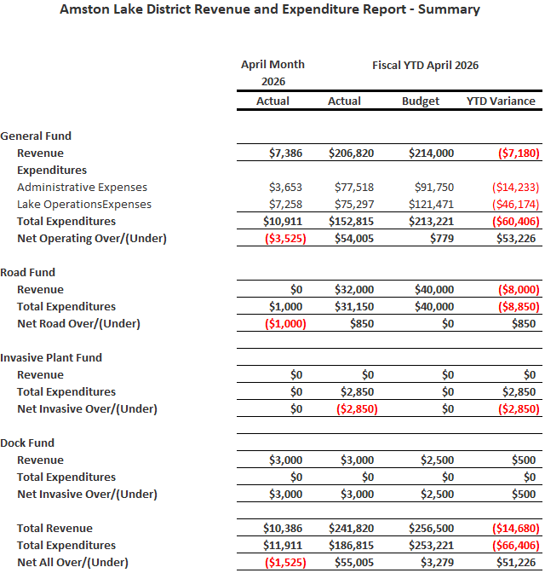


YTD Financial Results

Slide 29
Fund Balances

Slide 30
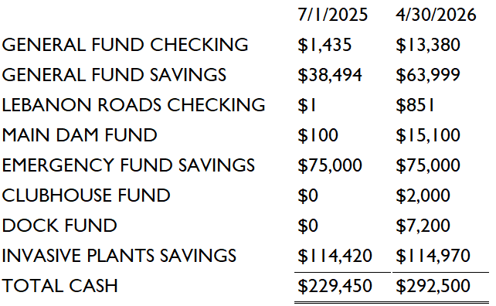
Cash Balances

Slide 31
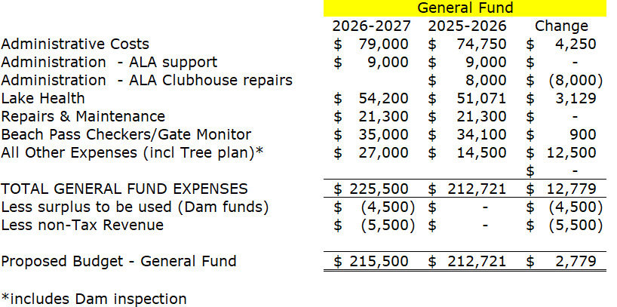
Proposed General Fund Budget

Slide 32
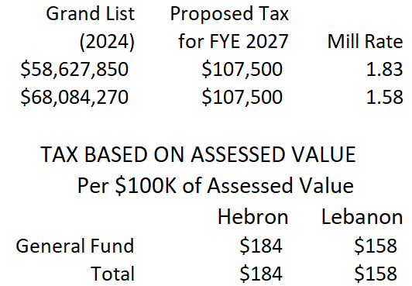
Proposed Tax based on Assessed Value General Fund

Slide 33
Consider and Act Upon Proposed 2027 General Fund Budget
Motion to vote on the FYE 6-30-2027 General Fund Spending Plan of $225,500 of which $215,500 will be funded with new tax revenue and the balance of $10,000 will be funded using non-tax revenue and existing funds
Second
Any Discussion?
Time to Vote

Slide 34
Voting – General Fund Budget
FYE 6-30-2027
Votes Tallied
Results Announced
  Approved or Rejected

Slide 35
Proposed Road Fund Budget
 | Lebanon Roads
Road Repairs & Maintenance | $ 19,000 | $ 19,000 | $ -
Plowing & Sanding | 21,000 | 21,000 | -
TOTAL LEBANON RD FUND EXPENSES | 40,000 | 40,000 | -
Less approved surplus to be used | - | - | -
Proposed Budget - Lebanon Roads Fund | $ 40,000 | $ 40,000 | $ -

Slide 36
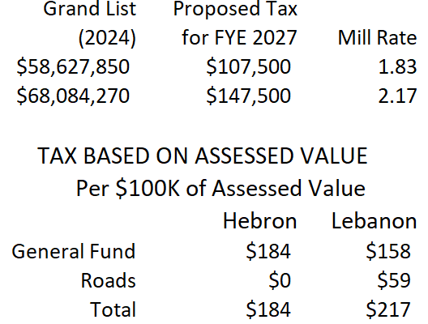
Proposed Tax based on Assessed Value General and Road Funds

Slide 37
Consider and Act Upon Proposed Budget for Lebanon Roads
FY 2026-2027
Motion to vote on the FYE 6-30-2027 Lebanon Road Fund Spending Plan of $40,000 which will be funded with new tax revenue of $40,000
Second
Discussion
Vote (Lebanon Residents Only)

Slide 38
Voting – Lebanon Roads Fund Budget FY 2026-2027
Votes Tallied
Announce Roads Budget Approved or Rejected

Slide 39
Special Project – Dock Expansion Opening Statement
At the Regular Board Meeting in May, the Board voted to present the Dock Expansion Project to the district voters
The cost of the expansion is $27,780
The current balance in the dock fund is $10,200
The balance remaining for the project cost was $17,580 and proposed as taxes
After the meeting I realized that the 2027 Dock fees were not included in the balance calculation.
Those fees are projected at $4,500 and therefore reduce the taxes necessary to perform this project down to $13,080
I apologize for the omission and present the adjusted tax request at the lower amount for review and vote

Slide 40
Special Project – Dock Expansion
Current inventory is 17 slips total, 4 Large and 13 small
  Note 2 small slips at Main are rented as a large slip
Increases total slip inventory from 17 slips to 20 slips [10 large slips and 10 small slips]
Increases flexibility based on community needs: large slips can also be utilized for smaller boats (sometimes 2!)
Cost of Project $27,780
  Material and installation cost
All Dock maintenance costs going forward will be paid for by Dock Slip rental fees
  Costs for Winter storage/Spring placement
  Repair/replacement
Dock fees in future years will pay back this investment over time (3 years)

Slide 41
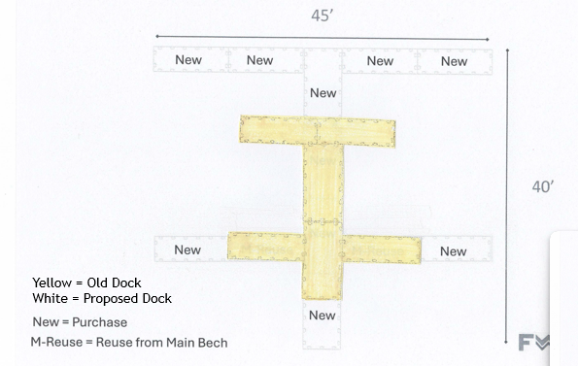
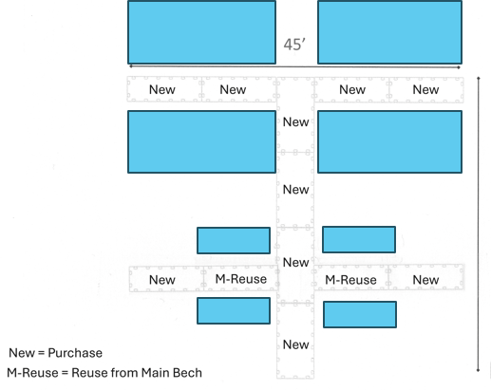
Main Beach Changes

Slide 42
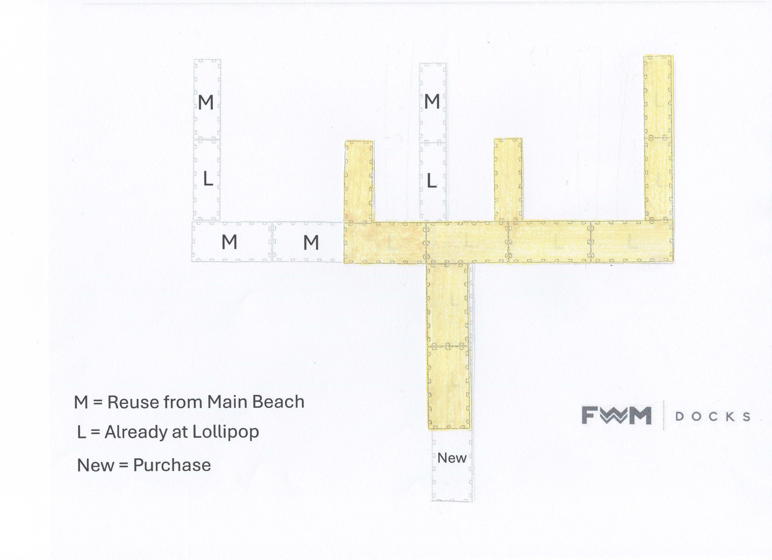
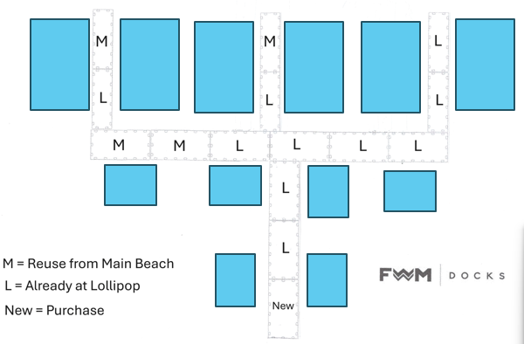
Lollipop Changes

Slide 43
COST FOR PROPOSED CHANGES
$27,780
$10,200 Funds Available in Dock Fund
$ 4,500 2027 Dock Rental Fees
$13,080 Balance Remaining
Estimated General Fund Pay Back Period
  $4,500* X 3 years = $13,500
*based on current rental rates 10 large boats (@ $300 each) & 10 small boats (@ $150 each); per slip rental fees could be increased over time to shorten pay back period.

Slide 44
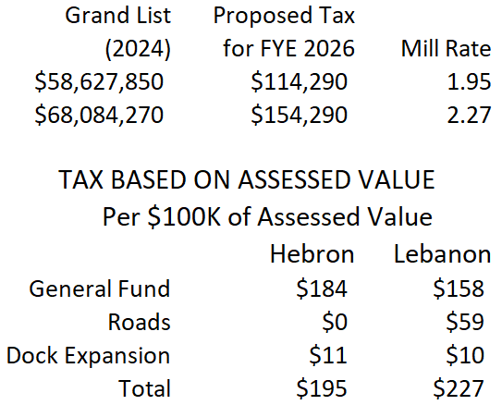
Proposed Tax based on Assessed Value (General, Road and Special Project Funds)

Slide 45
Consider and Act Upon Proposed Dock Expansion Project
Motion to vote on the FYE 6-30-2027 Special Project Dock Expansion Spending Plan of $27,780 of which $13,080 will be funded with new tax revenue and the balance of $10,000 will be funded using dock slip revenue and existing funds
Second
Discussion
Vote

Slide 46
Voting – Special Project Dock Expansion
Votes Tallied
Announce Approved or Rejected

Slide 47
Establish Date for 2027 Annual Meeting
Move to hold Annual District Meeting
Saturday, May 29, 2027 (location TBD)
Second
Any discussion?
Time to vote

Slide 48

Adjournment
Can I get a motion that we adjourn?
Second
Any discussion?
Time to vote
Thank you and have a
wonderful summer!

